Slide 1
Retention: Best Practices and Faculty Professional Development
National Visiting Committee Atlanta GA February 2011
Ken Yanow
Professor of Geographical Sciences
Southwestern College
kyanow@swccd.edu
Funded by National Science Foundation Advanced Technological Education program [DUE #0801893]. Author’s opinions are not necessarily shared by NSF

Slide 2
Retention
Goal
Determine best practices to retain GST students
Disseminate information
Methods
Conduct two nationwide surveys
one for geospatial faculty
one for geospatial student
Conduct literature review
Deliverables - dissemination
White paper, webinar(s), website(s), and conferences.

Slide 3
National Retention Surveys
To Educators: As we know, students tend to drop out of a class or a program for a variety of reasons. The GeoTech Center is seeking to determine the best-practice methods to retain students in geospatial coursework and/or programs (including all students, but especially traditionally underserved and underrepresented student groups). The following list of practices generally represent the most widely used and most successful retention techniques*. From the list, please select your top four techniques to retain students (the choices are in no particular order). If you practice something that is not listed, please select “other” as one of your choices and provide a short description:
To Students, One of the goals of the National GeoTech Center is to determine and disseminate the best practices of academic retention. We want to hear from you. The information you provide will help institutions across the nation develop and/or enhance their geospatial tech course offerings. Thank you very much for your participation. The survey will take about 2 minutes to complete.
Personal questions regarding demographics…then:
From the list below, please select the top four variables that truly aided you in reaching your goal(s) at the institution you attended. The choices are in no particular order. If something is missing, please select “other” and provide a short description:

Slide 4
Faculty vs. Students
 | Faculty Response (n=127) | Overall Student Response (n=101) | DIFF
Project based learning. |  | 50% | --
Strong Institutional Support. | 13% |  | --
Accessible faculty. Faculty mentoring. | 41% | 42% | 1%
Positive and relatable role models. | 19% | 21% | 2%
Curriculum that is contextual and relevant. | 55% | 51% | 3%
Activities that strengthen math or spatial skills. | 22% | 29% | 7%
Positive reinforcement. | 27% | 34% | 7%
Interaction with fellow students. | 47% | 37% | 10%
Good and motivated teacher(s). | 66% | 81% | 15%
Participation in service learning. | 24% | 2% | 22%
Participation in a research project. | 40% | 10% | 30%
Involvement in an internship/work experience. | 45% | 13% | 32%

Slide 5
Male & Female Students
 | Female (n=45) | Male (n = 56) | DIFF
Positive and relatable role models. | 20% | 21% | 1%
Good and motivated teacher(s). | 80% | 79% | 1%
Project based learning. | 49% | 48% | 1%
Participation in a research project. | 9% | 11% | 2%
Activities that strengthen math or spatial skills. | 31% | 27% | 4%
Participation in service learning. | 4% | 0% | 4%
Interaction with fellow students. | 33% | 39% | 6%
Positive reinforcement. | 38% | 30% | 8%
Accessible faculty. Faculty mentoring. | 47% | 38% | 9%
Involvement in an internship/work experience. | 18% | 9% | 9%
Curriculum that is contextual and relevant. | 56% | 45% | 11%

Slide 6
Student Age Groups
 | <25 to 36 (n=56) | 37 to 69 (n=44) | DIFF
Participation in service learning. | 2% | 2% | 0%
Good and motivated teacher(s). | 79% | 80% | 1%
Participation in a research project. | 9% | 11% | 2%
Accessible faculty. Faculty mentoring. | 39% | 43% | 4%
Positive reinforcement. | 30% | 36% | 6%
Involvement in an internship/work experience. | 9% | 18% | 9%
Activities that strengthen math or spatial skills. | 34% | 23% | 11%
Positive and relatable role models. | 27% | 14% | 13%
Project based learning. | 55% | 41% | 14%
Curriculum that is contextual and relevant. | 61% | 36% | 25%
Interaction with fellow students. | 23% | 55% | 32%

Slide 7
Student Age Groups: Male vs. Female
 | Female <25 to 36 (n=25) | Male <25 to 36 (n=31) | DIFF
Activities that strengthen math or spatial skills. | 32% | 35% | 3%
Good and motivated teacher(s). | 80% | 77% | 3%
Participation in service learning. | 4% | 0% | 4%
Interaction with fellow students. | 20% | 26% | 6%
Involvement in an internship/work experience. | 12% | 6% | 6%
Participation in a research project. | 4% | 13% | 9%
Accessible faculty. Faculty mentoring. | 44% | 35% | 9%
Positive reinforcement. | 36% | 26% | 10%
Positive and relatable role models. | 20% | 32% | 12%
Project based learning. | 48% | 61% | 13%
Curriculum that is contextual and relevant. | 76% | 48% | 28%

Slide 8
Student Age Groups: Male vs. Female
 | Female 37 to 69 (n=20) | Male 37 to 69 (n=24) | DIFF
Good and motivated teacher(s). | 80% | 79% | 1%
Participation in service learning. | 5% | 0% | 5%
Participation in a research project. | 15% | 8% | 7%
Positive reinforcement. | 40% | 33% | 7%
Interaction with fellow students. | 50% | 58% | 8%
Accessible faculty. Faculty mentoring. | 50% | 38% | 12%
Involvement in an internship/work experience. | 25% | 13% | 12%
Curriculum that is contextual and relevant. | 30% | 42% | 12%
Positive and relatable role models. | 20% | 8% | 12%
Activities that strengthen math or spatial skills. | 30% | 17% | 13%
Project based learning. | 50% | 33% | 17%

Slide 9
Online vs. Hybrid/Face-to-Face students
 | online (n=45) | hybrid/face (n=55) | DIFF
Accessible faculty. Faculty mentoring. | 42% | 42% | 0%
Good and motivated teacher(s). | 80% | 80% | 0%
Participation in service learning. | 2% | 2% | 0%
Project based learning. | 49% | 49% | 0%
Curriculum that is contextual and relevant. | 49% | 51% | 2%
Activities that strengthen math or spatial skills. | 31% | 27% | 4%
Participation in a research project. | 7% | 13% | 6%
Involvement in an internship/work experience. | 9% | 16% | 7%
Positive reinforcement. | 38% | 31% | 7%
Positive and relatable role models. | 9% | 31% | 22%
Interaction with fellow students. | 22% | 49% | 27%

Slide 10
Online, Female vs. Male
 | online female (n=23) | online male (n=22) | DIFF
Involvement in an internship/work experience. | 9% | 9% | 0%
Positive and relatable role models. | 9% | 9% | 0%
Participation in service learning. | 4% | 0% | 4%
Participation in a research project. | 4% | 9% | 5%
Good and motivated teacher(s). | 83% | 77% | 6%
Curriculum that is contextual and relevant. | 52% | 45% | 7%
Interaction with fellow students. | 17% | 27% | 10%
Accessible faculty. Faculty mentoring. | 48% | 36% | 12%
Project based learning. | 43% | 55% | 12%
Activities that strengthen math or spatial skills. | 39% | 23% | 16%
Positive reinforcement. | 48% | 27% | 21%

Slide 11
Hybrid/Face-to-Face Female vs. Male
 | hybrid/face female(n=22) | hybrid/face male(n=33) | DIFF
Good and motivated teacher(s). | 77% | 79% | 2%
Participation in a research project. | 14% | 12% | 2%
Interaction with fellow students. | 50% | 47% | 3%
Positive and relatable role models. | 32% | 29% | 3%
Positive reinforcement. | 27% | 32% | 5%
Participation in service learning. | 5% | 0% | 5%
Activities that strengthen math or spatial skills. | 23% | 29% | 6%
Accessible faculty. Faculty mentoring. | 45% | 38% | 7%
Project based learning. | 55% | 44% | 11%
Curriculum that is contextual and relevant. | 59% | 44% | 15%
Involvement in an internship/work experience. | 27% | 9% | 18%

Slide 12
Professional Development Workshop Examples

Slide 13
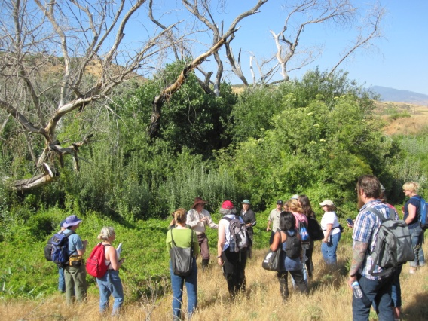
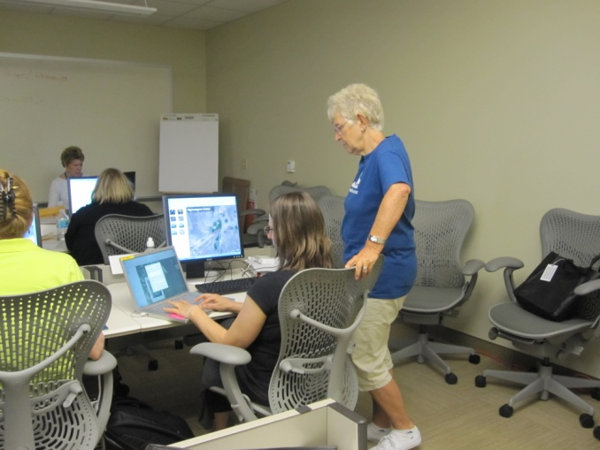
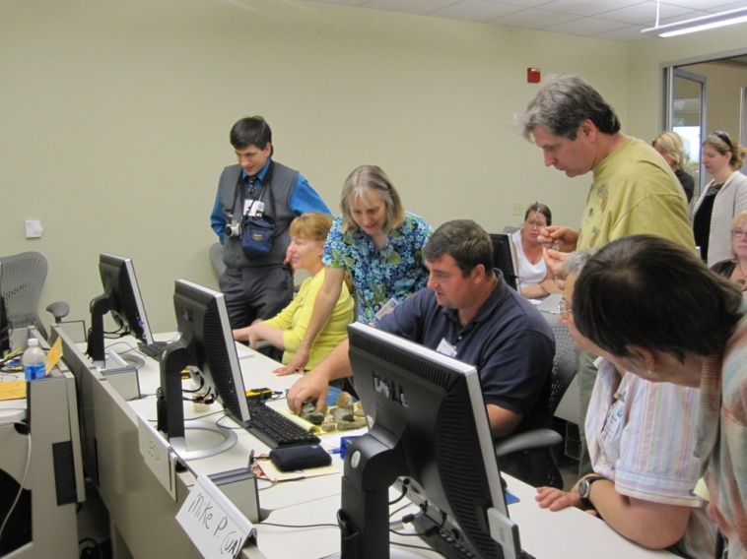
Teachers Teaching Teachers – T3GIS
Teaching “Teaching” Techniques –
not software
Co-Hosted by Esri and GeoTech
Notes:
GeoTech has co-hosted this event the last two years and also provided stipends to support the participants that then teach or present to other teachers the year following their participation. The quality of Trainers, the ratio of trainer to educator and the length of the event (8 days), and the rigorous application process to be accepted helps develop a strong since of community. The 50 plus educators that have participated continue to communicate and help each other.
This event is NOT to teach software, but to help educators learn effective methods to introduce and expand the geospatial knowledge of other educators in order to introduce it to more students!
It includes a “field” event where each participant has to develop a project of their choosing about the location and share with other participants.
Also included are sessions and resources to help educators learn all of the steps to setting up and holding a variety of professional Development events.

Slide 14
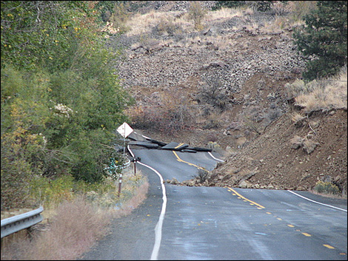
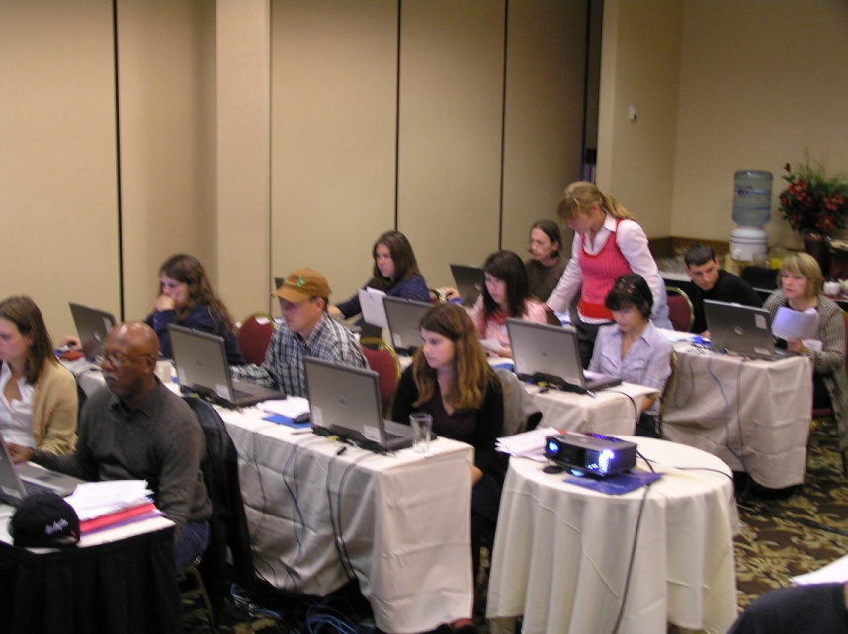
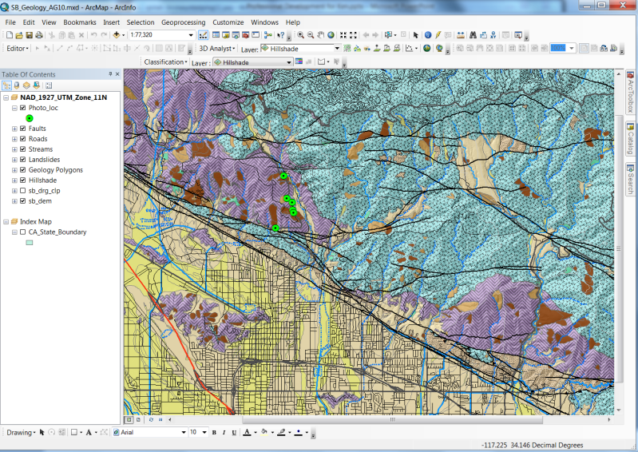
Geological Society of America Two Day Workshops
Teaching “Teaching” Techniques; providing GIS, and spatial analysis training.
Notes:
Ann Johnson and Joseph Kerski have taught these workshops which take participants from “no GIS” knowledge to doing intermediate to advanced processes focused on geological applications. It is a great opportunity for earth science educators to learn methods to introduce the technology to their students and for the staff to learn what industry needs.

Slide 15
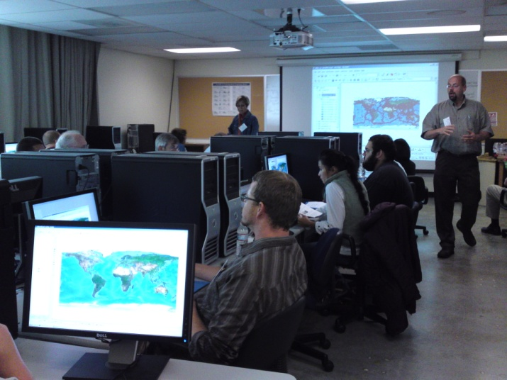
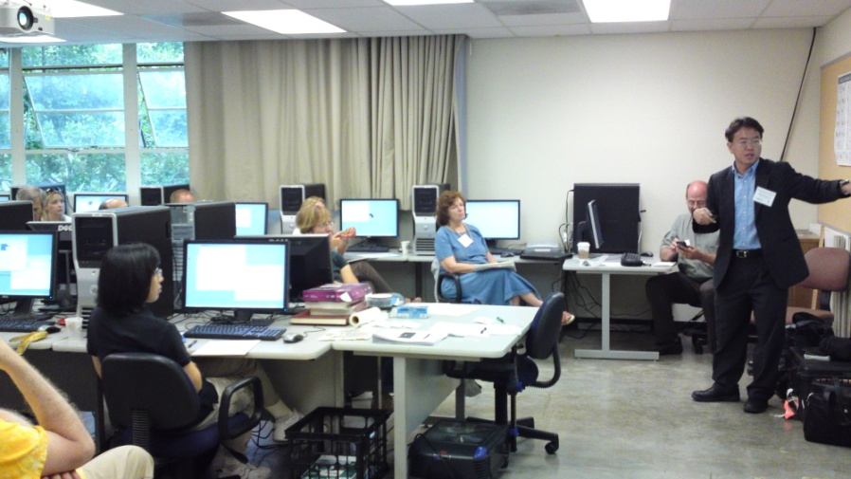
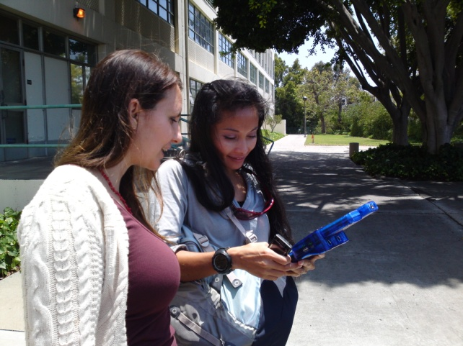
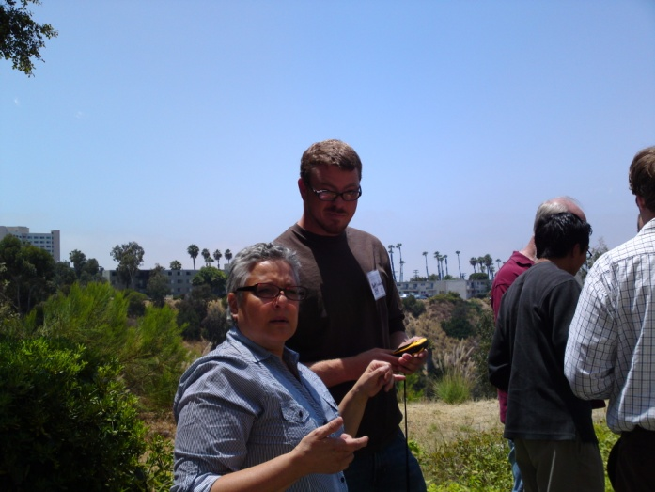
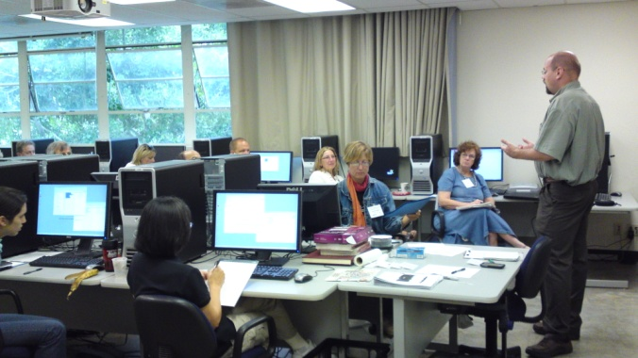
Southwestern/SDSU Joint Three Day Workshop
Teaching “Teaching” Techniques; providing GIS, GPS, and spatial analysis training.

Slide 16
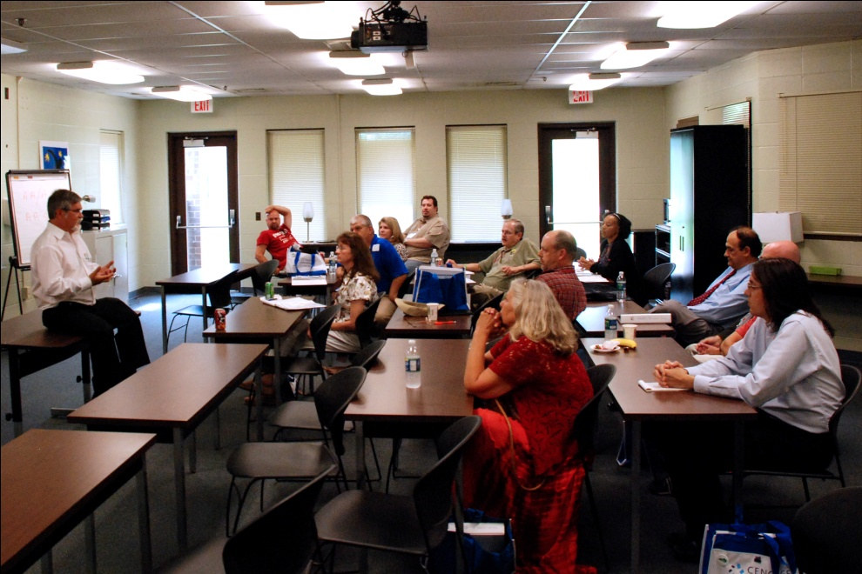
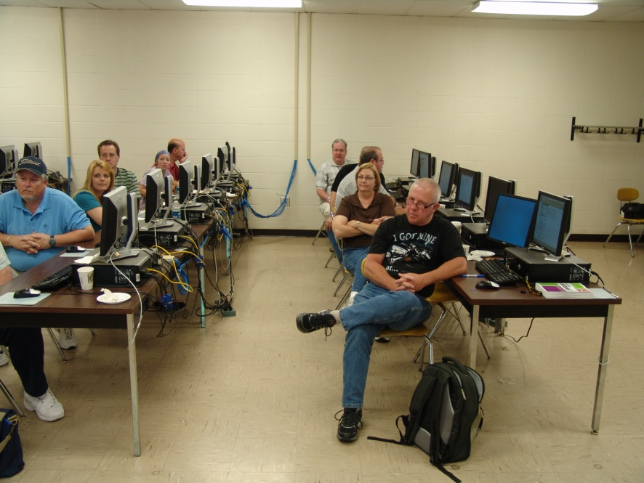
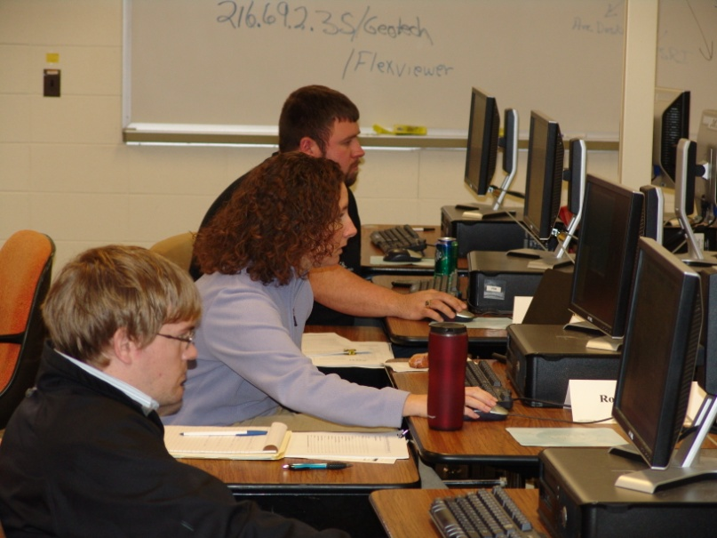
GeoEd 2010
Keynote Speakers, pre-conference workshops.

Slide 17
Student Outreach – Increasing Awareness of Geospatial Careers National Visiting Committee Atlanta GA February 2011
Ann Johnson
Associate Director
gisajohnson@delmar.edu
Funded by National Science Foundation Advanced Technological Education program [DUE #0801893]. Author’s opinions are not necessarily shared by NSF

Slide 18
Awareness of Careers and Opportunities for Students
In addition to “program support”
Learn about geospatial careers
Develop and practice workforce skills
GTCM skills & competencies
Certification Options
Develop presentational skills and other soft skills desired by industry
Network with working professionals
Develop a “Global Perspective”

Slide 19
Opportunities for Geospatial Students
Some examples
Poster Competitions (UCGIS, ASPRS, etc.)
Scholarships (ASPRS, USGIF, etc.)
Volunteer Worker at Conferences
Summer Internships in Industry/Government
International exchanges
“Rules” disqualify two year college students
Especially those in “CTE” programs
Part time students

Slide 20
National Geospatial Skills and Competencies Competition
“Three Round” competition
Round 1 - Exam
Individual student take and pass (70%) exam based on the GTCM
If pass with 85% get Recognition Certificate
Round 2 - Project
Student creates project and upload video judged by professionals (no college faculty)
Round 3 - Esri EdUC presentation
Top 6 semi-finalists judged by audience for 1st, 2nd, 3rd place awarded at CC SIG

Slide 21
Competition Designed To:
Check their skills against a National Standard (GTCM)
Prepare and pass exam as practice for “Certification” exams (GISCI, ASPRS)
Develop Critical Thinking skills and presentation skills
Learn about professional conferences and networking

Slide 22
International EU Pilot Project
Build a Global Perspective for CC students
Work with diverse student group
U.S. and International
Learn how other cultures use
geospatial technology
Work on a research project
Concepts, lab and field work
Learning “problem solving” techniques
for “different” problems

Slide 23
EU Project Details
Length of time: 2 weeks in Netherlands
10 U.S. Community College students
Selected from across U.S. via application
10 Netherlands students (non-funded)
Two U.S. GeoTech partner faculty
Two faculty from Netherlands
University of Groningen (RUG), Faculty of Spatial Sciences, Groningen Centre of Spatial Information and the Geo Academy educational unit of GeoFort

Slide 24
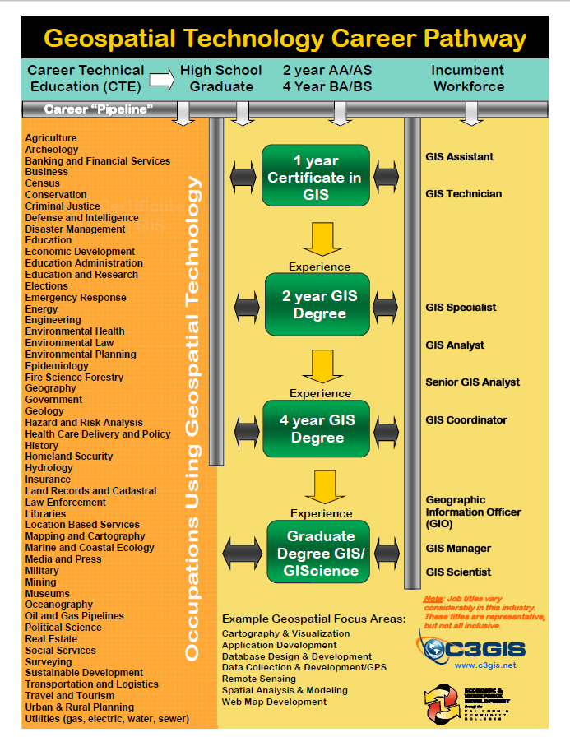
Resource for Students
Career Guidelines (2011)
handouts and web site links to:
Organizations
Job posting sites
Conferences
Videos
“Self Assessment”
modified GTCM Program Assessment
National Geospatial Technology Skills Competition

Slide 25
Future of the GeoTech Center 2012 and Beyond National Visiting Committee Atlanta GA February 2011
Phillip Davis
Director
pdavis@delmar.edu
Funded by National Science Foundation Advanced Technological Education program [DUE #0801893]. Author’s opinions are not necessarily shared by NSF

Slide 26
GeoTech 2.0 (2013-2015)
Leverage GTCM to double articulation rate between two and four year colleges
Increase number of two year colleges offering geospatial technology
Increase two year college faculty participation in professional organizations
Develop national network of distance learning course offerings for a mobile workforce

Slide 27
GeoTech 2.0 (2013-2015)
Promote FOSS4G for wider adoption among two year college programs
Establish research experiences for undergraduates (REU) program for two year college faculty and students
Seek additional funding to leverage NSF dollars
Increase private industry participation to promote sustainability
Continue the effort to increase minority and female participation

Slide 28
Revise GTCM (by 5th year)
Continue Meta-DACUM efforts
Tier 6, 7 and 8 for additional occupations
Work to review occupational titles/content
Provide “technology sandbox” to
Allow educators access to new technology
National CC geospatial consortium
Articulation and course “sharing”
GE for remote sensing courses
Additional GUI and capabilities for National CC Program Map and database
Internship & ePortfolio demonstrations

Slide 29
Discussion for Session 3

